Slide 1
Green Business Management
BY –PURVA B. SAKPAL

Slide 2
Concept of green management
Green management is a paradigm that includes improving environmental awareness, using energy resources and eco-friendly technologies, reuse of wastes, and recycling activities starting from production activities of businesses to packaging and delivering to consumers.

Slide 3
Green Business
An enterprise that has minimal negative impact or potentially a positive effect on the global or local environment, community, society, or economy—a business that strives to meet the triple bottom line.
They cluster under different groupings and the whole is sometimes referred to as "green capitalism.
Often, sustainable businesses have progressive environmental and human rights policies.

Slide 4
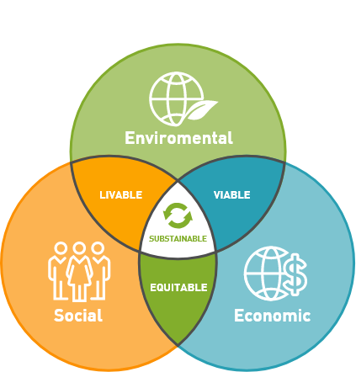
Sustainable businesses
Sustainability consists of fulfilling the needs of current generations without compromising the needs of future generations, while ensuring a balance between economic growth, environmental care and social well-being. Sustainability is made up of three pillars: the economy, society and the environment.

Slide 5
Common Characteristics of Green companies:-
Minimum use of plastic material
Use recyclable packaging material.
Recyclable papers.
To reduce wastage of Resources
To reduce degradation of environment
To save the scacre resources for the future generations.

Slide 6
Scope of Green business Management
Green Foods: Green business ideas allows people too grow “garden parks” or small seeded trays that can be placed anywhere at your surroundings.
Green Consulting: Green consulting is the one of the best low budget businesses. All you need is to know best advertising methods for business and need a mobile or email id, so that people can contact.
Green vehicles: Using of electric scooters an small electric cars. The cope is endless – once you start thinking about your environment for the pollution free and fuel saving market.
Green Appliances (energy star logo)

Slide 7
GREEN RE-ENGINEERING
BY-IRFAN KHAN

Slide 8
What is Re-Engineering
Business Process Re-engineering(BPR) is a
management approach aiming at improvements by means of elevating
efficiency and effectiveness of the processes that exist within and across
organizations.
It is a fundamental and radical approach by either modifiying or eliminating non-value adding activities.
Re-Engineering can be accomplished through the implementation of ERP systems

Slide 9
WHY Re-Engineering
Historical ‘reality’ for organization:
-High level of demand:
-Management(and IT)focus- efficiency and control of operations.
Modern ‘reality’ since 1990s:
-Hyper-competiveness
-Globalization
-Very demanding customers
-Management and It focus: Innovation, responsiveness/speed, quality and service

Slide 10
Business Process Re-engineering(BPR)
Business Process: “A business process is a collection of activities which together produces some value to the customer “
Re-engineering: Re-Engineering is fundamental rethinking and radical redesing.

Slide 11
INTRODUCTION
Business processes, representing the way in which business operate, play a significant role in contribution towards the carbon footprint of an organization. Repetitive erroneous processes not only make for an inefficient business but also result in high carbon generation. The “Carbon footprint” of an organization represents the CO2 from emissions throughout the life cycle of a product, service or activity and contributes to increased atmospheric carbon levels .One approach for businesses to maintain sustainable operations whilst addressing its carbon footprint would be to identify the extent of carbon emissions resulting from their business processes. This has to be followed by a framework within which green business process operates that is based on Business Process Reengineering (BPR) to minimize carbon emissions. This position paper presents a framework for “Green Business Process Reengineering Life Cycle” with a specific focus on CO2 emitting business processes. This paper further proposes a carbon reporting mechanism as part of the business reports, identifying and evaluating alternate processes, and moving towards measuring and justifying their changes. Starting with a literature review in identifying carbon emitting business processes and characteristics in transforming them to green processes, a discussion is developed on challenges in implementing green processes. From this discussion, a green reengineering framework is proposed that establishes a research agenda in the Green Business domain from the information systems management perspective. The paper concludes with delineating concepts of validating the proposed framework and future research directions.

Slide 12
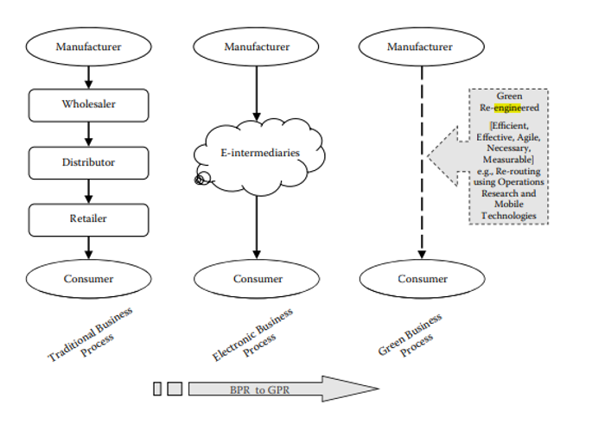
Figure illustrates the concept of process reengineering in a simple way from a green perspective. Ā simple distribution process on the left in Figure shows a manual distribution

Slide 13
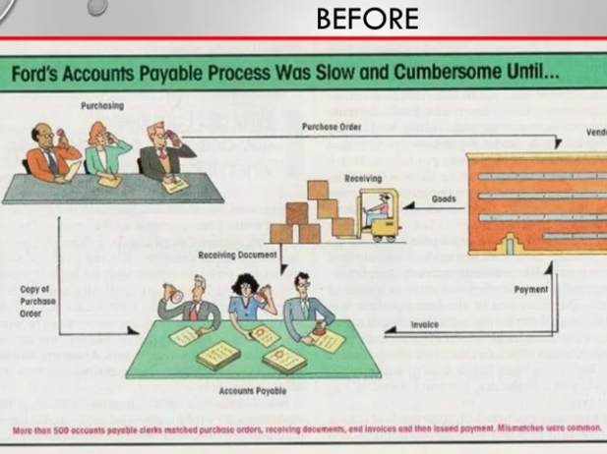
Case Study
Of Ford Accounts Payable Process

Slide 14
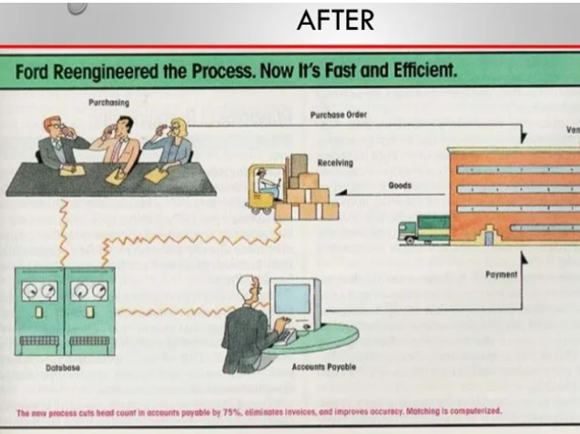

Slide 15
Trigger For Fords’s AP Re-Engeeniring
Mazda only uses 1/5 personnel to do the same Accounts payable.(ford:500;Mazda:5)
When goods arrive at the loading dock at Mazda:
-Use Bar-code reader is used the loading dock at mazda
-Inventory data are updated.
-Send electronic payment to the supplier.

Slide 16
Ford Accounts Payable
Before
More than 500 accounts payable clerks matched purchase orde,receiving documents and invoices and then issued payment.
It was Slow and burdensome
Mismatches were common.
After
The new process cuts head count in AP by 75%
Invoices are eliminated.
Matching is computerized.
Accuracy is improved.

Slide 17
BPR Management Technique Focused
Customer focus-Customer service oriented processes aiming to eliminate customer complaints .
Speed-Dramatic compression of the time it takes to complete a task for key business processes.
Flexibility-Adaptive processes and structures to changing conditions and competition.
Quality-obsession with the superior service and value to the customers.
Innovation-Leadership through imaginative change providing to organization competitive advantage .
Productivity-improve drastically effectiveness and efficiency

Slide 18
Benefits of Re-Engineering
Eliminates waste, and obsolete or inefficient process
Significant reduction in cost and time.
Revolutionary improvements in many business processes as measured by quality and customer service
Increasing the Competency of both top and low level companies

Slide 19
THANK YOU

